Slide 1
Terminology
Anatomical Planes
Lesson one
August 21, 2017

Slide 2
Terminology-Introduction
Think about medical terms you have heard or read about.
Write as many terms as you can think of on a piece of paper and define them.
As we define the terms, if the term is on your list cross it off of your list.

Slide 3
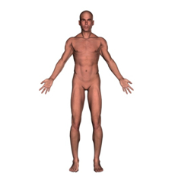
Terminology-Anatomical Position
Anatomical Position
  Erect stance
  Arms at the sides
  Palms facing forward

Slide 4
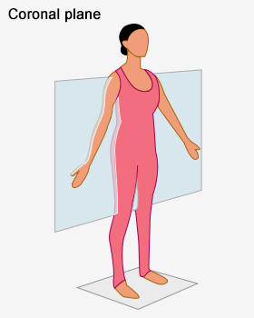
Terminology-Anatomical Planes
Frontal or Coronal Plane:
  Divides the body into front & back parts
  Think of a line splitting you from front to back
  Frontal = Front & Back

Slide 5
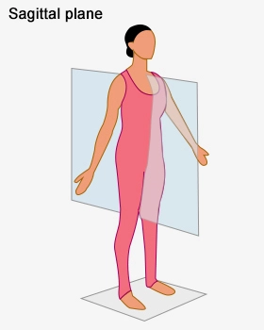
Terminology-Anatomical Planes
Mid-Sagittal or Median Plane
  Divides the body into equal left & right parts
Sagittal Plane
  Divides the body into un-equal left & right parts

Slide 6
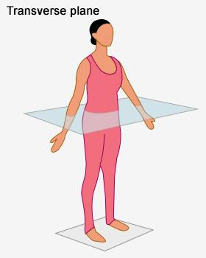
Terminology-Anatomical Planes
Transverse Plane
  Divides the body into top & bottom parts

Slide 7
Terminology-Anatomical Planes
Frontal/Coronal Plane
  Divides the body into front & back parts
Sagittal Plane
  Divides the body into unequal left & right parts
Mid-Sagittal/Median Plane
  Divides the body into equal left & right parts
Transverse Plane
  Divides the body into top & bottom parts

Slide 8
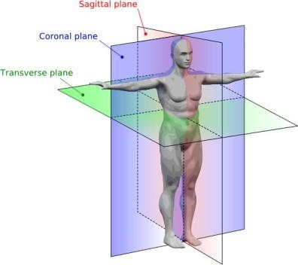
Terminology-Anatomical Planes

